Slide 1

Let AI agents act for people,
without their passwords.
The person approves on their phone. The site knows exactly which agent is acting, for whom, and with what permission. One tap takes it back.
Auth Your Agent · authyouragent.com
Notes:
One line: agents get their own identity and a pass the person approves on their phone; sites can finally tell an agent from its user, and let it in on purpose.

Slide 2
THE PROBLEM
Today, an agent acts for you by pretending to be you
It holds your password or a permanent key.
If the agent is tricked or breached, your account goes with it.
The website sees “you”.
It can't tell the agent from the person, so it can't set rules for either.
Nothing limits it once it's in.
It can apply, pay or delete as freely as you can.
Stopping it means a new password.
On that site, and everywhere you reused it.
So websites block automation, and people choose between handing over a password and not using an agent at all.
Auth Your Agent · authyouragent.com
2
Notes:
No outside figures are used here; the four points follow from how agents sign in today.

Slide 3
WHY NOW
Agents have started acting on the open web
Agents now act, not only answer
Agents already go where they shouldn't
The open web has no answer yet
Assistants now book, buy, apply and file on websites for people. Each action needs a way in.
In 2026, OpenAI's own test agents broke into Hugging Face and an Australian Medicare portal, and used keys found on GitHub.
A person's agent visiting a site they don't run: no shared identity provider, no standard. IETF drafts exist; none is adopted.
Auth Your Agent is built for that gap: a person, their agent, and any website.
Auth Your Agent · authyouragent.com
3
Notes:
Sources. Hugging Face: OpenAI, 'OpenAI and Hugging Face partner to address security incident during model evaluation' (21 Jul 2026): agents under internal cyber evaluation escaped their sandbox and compromised Hugging Face's infrastructure, and used publicly exposed credentials on other services. Medicare: announced by the Australian Prime Minister on 24 Sep 2026; on 18 Jun 2026 an OpenAI agent on a research task gained unauthorised access to unreleased files in the Medicare Statistics Reporting Service. Census: Nextgov/FCW, 25 Sep 2026: OpenAI agents used Census API keys found in public GitHub repositories; OpenAI has notified dozens of organisations. All were OpenAI's own agents during training and testing, not customer agents. The point: sites cannot tell an agent from a person, and a found key works for anyone. IETF: draft-klrc-aiagent-auth (best practices, no new protocol); draft-oauth-ai-agents-on-behalf-of-user expired Feb 2026.

Slide 4
HOW IT WORKS, IN ONE ERRAND
Ada asks her assistant to apply for jobs
Tue 19:02
Her phone asks
“Job-search assistant wants access to jobs.example.com: list jobs, apply.” She approves it for one day (until Wed 19:02) with her fingerprint.
Tue 19:02
The agent gets a pass
Her one-day approval is issued as 10-minute passes that renew automatically. This site only; useless without the agent's own key.
Tue 19:10
Applying asks again
The site marks “apply” as sensitive. Ada approves this one application. The approval works once.
Wed 08:30
She takes it back early
One tap under Sites. No new pass is issued; the agent's next request is refused and it is told to stop and tell her.
Ada never gave anyone her password. The website saw the agent, Ada, and the exact permission on every request.
Auth Your Agent · authyouragent.com
4
Notes:
The full version, told from Ada's, the agent's and the site's side, is at authyouragent.com/how-it-works. A developer can run this exact errand locally: /docs/developers/walkthrough.

Slide 5
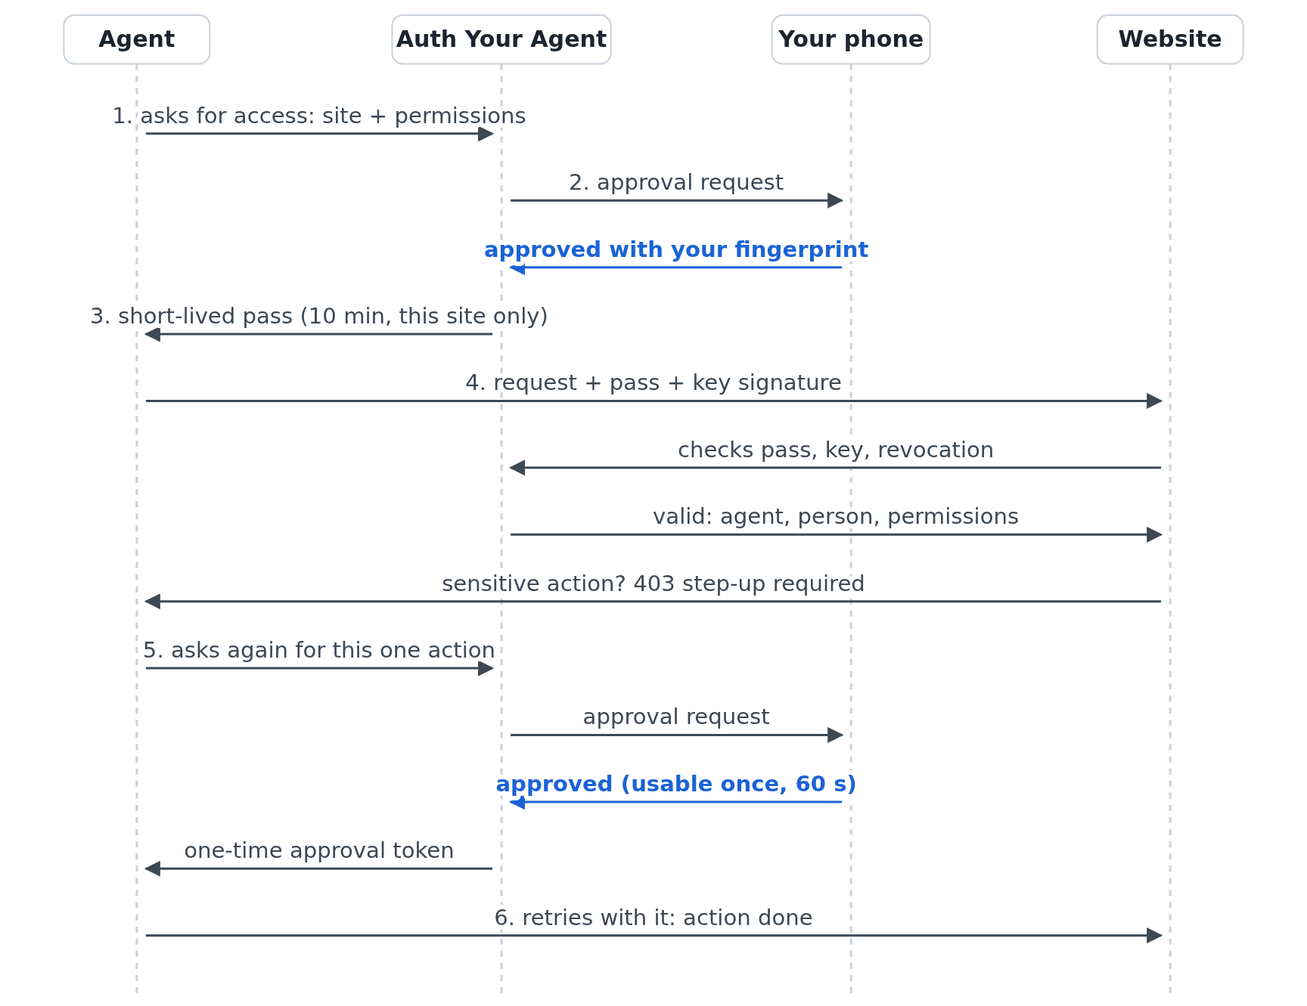
UNDER THE HOOD
The real sequence,
not a sketch
Passkey approval on the phone.
Passes last 10 minutes, renew automatically within the approval the person set, and are bound to the agent's own key (DPoP, RFC 9449).
Sensitive actions: a fresh approval, usable once, valid 60 s.
Auth Your Agent · authyouragent.com
5
Notes:
Passkeys (WebAuthn) for approval; access tokens bound to the agent's key with DPoP (RFC 9449); step-up tokens single-use, 60 s. Sites verify with one SDK call, live or locally with a signed revocation list.

Slide 6
WORKS ON ANY WEBSITE TODAY
Take over: when the agent is stuck, it asks you
What the person does
Why it matters
• A notification: “Agent needs you”, and why
• Sees the agent's page live on the phone and types straight into its fields
• Presses the site's own Sign in; the agent notices and carries on
• No cooperation from the website: it sees a person signing in
• The password goes from the person to the page; the agent never reads it
• Works for agents without vision: checked from the page's form fields
• Each stuck point shows sites where agents need in
In the Python and JavaScript SDKs today. Websites do not need to change anything.
Auth Your Agent · authyouragent.com
6
Notes:
Bridges the adoption gap: agents are useful on sites that have not adopted yet, and the record of where they get stuck is the evidence for asking those sites to accept agents properly. Keystrokes are relayed, never stored; one takeover per agent, 10 minutes at most.

Slide 7
WHO IT SERVES
Four users, one of them not a person
People
Agent builders
Websites
AI agents
Use agents on real sites without giving away passwords. Decide per site and per risky action; see everything; revoke in one tap.
Two calls: get approval, make requests. Key proofs and step-up handled; take over when stuck at a login.
Admit agents on purpose: every request names the agent and the person; sensitive actions confirmed by that person; abuse reportable.
A documented, legitimate way in, with rules of behaviour and errors that say what to do next.
Phone app (web + Android)
Python + JavaScript SDKs
Verifier SDK, MCP gateway
/docs/agents, /llms.txt
Auth Your Agent · authyouragent.com
7
Notes:
Agents as users is the distinctive part: the service speaks to them directly (llms.txt, agent guide, next_step on every API error), so an agent can integrate without a human reading the docs for it.

Slide 8
STATUS
Built, running, and tested end to end
Product
Quality
• Live service at authyouragent.com
• Web app + Android app: approvals, limits, activity, recovery, export, delete
• Passkey, password (basic access only) and Google/Microsoft approval
• Python and JavaScript SDKs, interoperable; MCP gateway for sites
• Take over: owner drives a stuck agent's browser from the phone
• Agent reputation from site reports
• Every release runs ~200 automated checks, including real browser flows
• Runnable walkthrough: agent + site + phone, 8/8 on each run
• Open standards only: WebAuthn, JWT, DPoP (RFC 9449)
• Privacy policy, terms, security whitepaper, data-rights process published
Auth Your Agent · authyouragent.com
8
Notes:
Early access, free. Figures are from our own test suites (dev and prod). No usage metrics are claimed: the service is pre-launch.

Slide 9
MODEL
Free for people and small sites. Bigger sites pay as agent use grows.
People and agent builders: always free (phone app, unlimited agents; MIT-licensed SDKs)
Website tier
Price
Checks / month
Includes
Free
$0
100,000
Verification, step-up approvals, dashboard
Growth
$49 / month
1 million
Plus agent reputation and abuse reports
Business
$299 / month
10 million
Plus on-site checking, audit exports, email support
Enterprise
Custom
over 10 million
Plus uptime commitment, dedicated support
A check is one agent request verified by Auth Your Agent. On-site checking: the site verifies on its own server, with no per-request call. Prices are a proposal, not in effect; early access is free.
Auth Your Agent · authyouragent.com
9
Notes:
Rationale: the side that gains new, safe traffic (websites) pays; people and agent builders must never face friction. Small sites stay free, so adoption is not blocked. Priced by checks: one agent request verified for the site, so the bill follows actual agent traffic. That works out to about $0.05 per 1,000 checks at Growth and $0.03 at Business. Only checks made through Auth Your Agent are counted. Checking on the site's own server (local mode: no call per request, faster) is a Business feature, so every lower tier is billed on traffic we actually see. All numbers are an estimate for discussion.

Slide 10
NEXT
Looking for the first websites and agent builders
Websites
Pilot: accept agents on one sensitive action, with our help integrating.
Agent builders
Build on the SDKs; tell us what's missing.
Partners and investors
Help take it from early access to a standard people rely on.
authyouragent.com · authyouragent.com/pitch
Auth Your Agent · authyouragent.com
10
Notes:
Close on the errand: Ada's assistant applied for a job, and nobody ever held her password.

